Slide 1

Credence IT Professional
Training Institute
Software Testing – Induction Session
Sunday, 12th Oct 2025
Contact No : 📞 +91 8237916162
📞 +91 7391053250
📞 +91 9579064658
📞 +91 9091929355
Email : 📧 info@credence.in
Web Site : 🌐 www.credence.in
Office Address : Indira Heights, Survey no. 34/5,Mohan Nagar, Dhankawadi, Pune, Maharashtra 411043

Slide 2


01. About Software Industry and Software Testing Overview of the software industry and the critical role of testing in ensuring quality. 02. Technical Training and On-Job Training Hands-on training in software testing tools and real-world scenarios. 03. Interview Training Comprehensive preparation for interviews to boost confidence and communication. 04. Personalized Resume Designing Resume designing process 05. Interview Calls Access to job opportunities with guidance for successful interviews. 06. Job Roles and Selection Process Support in choosing the right job aligned with your career goals. 07. Eligibility Criteria For Course Clear requirements to ensure the program is a good fit for you
08. Time and Duration Of Course Schedules with a streamlined process for quick placement. 09. Credence Software Testing Training Process Structured process ensures you are fully prepared for Software testing and achieve successful placement. 010. Course Certificate
Certificate acknowledges your dedication and expertise acquired during the training program
011. Credence Own Application for Notes and Classes Platform where you can access all course notes and attend classes
012. Laptop/System configuration Required laptop/desktop/ system details.
013. Tuition Fees Structures Fees structure and instalment details.
CONTENTS

Slide 3
01
About Software Industry
and Software Testing

Slide 4
What is Software :: Software is a collection of programs and data that tell a computer how to perform specific tasks.
Management
2
Design
1
It is a part of project management in which software projects are planned, implemented, monitored, and controlled.
It is the process of making software that show how it should be made, how it will work, etc.
Software
Testing
Development
3
4
It s the process used to create software by writing code.
It is the process of checking whether software satisfies expectations

Slide 5

02
Technical Training and On Job Training

Slide 6
Software Testing Approaches
NOTE HERE
Manual
Testing
Automation
Testing
NOTE HERE
NOTE HERE
NOTE HERE
Manual Testing : Testing in which a human
tester involves
Automation Testing : Testing in which set
of code or tools is used instead of a human tester

Slide 7
Software Testing Types, Tools and Projects
Important Note: This is not complete syllabus for more details refer Credence syllabus pdf
Detail level Syllabus Link : https://tinyurl.com/CredenceTestingSyllabus
Project Domains:
Healthcare Domain
Card Payment
Life Science
Insurance Domain
Telecom Billing/CRM/OSS/Mediation
Capital Market/Investment Banking
Automotive Domain
As per Market demand,
we will add some other important
domains if required.
Testing Types:
Functional Testing
Non Functional Testing
Performance Testing
GUI Testing
Database Testing
ETL Testing
BI Testing
API Testing
Tools :
SQL Developer
Sql server management studio
Visual studio +SSIS
Tableau
HPALM
Unix-Putty
Pycharm
Jira
Git
Jenkins
Postman
Jmeter
- Get notes and assignments/tests/ interview questions for every topic!

Slide 8
03
Interview Training

Slide 9
Interview Training
Technical Interview
Manager Interview
Client Interview
HR Interview

Slide 10
Interview Training
Group Mock
Telephonic
Mock
1-1 Mock
Group Mock Interview
Telephonic Mock Interview
1-1 Mock Interview
After completion of very big topic group mock interviews will be arranged
Mock interview after completing each subject's syllabus.
After completion of all syllabus candidate has to attend 1-1 mock interview and resume will be processed

Slide 11
04
Personalized Resume Designing

Slide 12

Personalized Resume Designing
Data Collection from the Candidate:
We collect detailed information directly from you, including your professional background,
skills, achievements, and career goals.
This ensures your resume reflects your unique strengths and experiences.
1-on-1 Personalized Discussions:
A dedicated expert will schedule a 1-on-1 call to discuss your profile in detail.
During this session, we understand your aspirations and tailor your resume accordingly.
Professional Resume Submission:
After finalizing your resume, we provide you with a polished, professional document
that’s ready to impress potential employers.
Every resume is tailored to your specific industry and role.
Portal Upload Assistance:
We guide you in uploading your resume on popular job portals for maximum visibility.
This increases your chances of landing the perfect opportunity.

Slide 13
05
Interview Calls

Slide 14
Interview Calls
Naukri Profile:
Create or enhance your profile on Naukri, ensuring it is tailored to attract recruiters.
Regularly monitor and update your profile to increase visibility and improve recruiter engagement.
LinkedIn Profile:
Build a professional and well-optimized LinkedIn profile that highlights your skills and experiences.
Actively network with industry professionals and recruiters to uncover hidden job opportunities.
Other Portals:
Explore platforms for targeted job hunting in specific industries.
Continuously engage with multiple platforms to increase the number of opportunities.
Internal and External reference:
Leverage references from previously placed candidates, external consultancy firms, and staffing agencies to unlock additional job opportunities.
Our Dedicated Telegram Channel :
Join our dedicated Telegram channel where our specialized HR team regularly posts curated job openings.
Benefit from direct support and guidance from our HR team throughout your application process.
Leverage this advantage to access market interview calls quickly, increasing your chances of securing job opportunities promptly.

Slide 15
06
Job Roles and Selection Process

Slide 16
Job Roles-1
No | Role Category | Job Title or Designation
1 | Manual Testing Roles | Manual Tester, QA Tester, QA Engineer, Software Tester, Functional Tester, Non-Functional QA Engineer
2 | Automation Testing Roles | Automation Tester, QA Automation Engineer, Selenium Tester, Test Automation Specialist, Automation Framework Developer, PyTest Framework Engineer
3 | Database Testing Roles | Database Tester, SQL Tester, Data Quality Analyst, Database Quality Engineer
4 | API Testing Roles | API Tester, Postman Tester, API Automation Engineer, Integration Tester
5 | Performance Testing Roles | Performance Tester, JMeter Specialist, Load Tester, Stress Tester, Performance QA Analyst
6 | Salesforce Testing Roles | Salesforce Tester, CRM Tester, Salesforce QA Engineer, Salesforce Functional Tester
7 | ETL/BI Testing Roles | ETL Tester, Data Warehouse Tester, BI Tester, ETL QA Analyst, Report Tester

Slide 17
Job Roles-2
No. | Role Category | Job Title or Designation
8 | Cloud Testing Roles | Azure Tester, Cloud Tester, Cloud QA Engineer, Cloud Infrastructure Tester
9 | Data Analyst Roles | Data Analyst, BI Analyst, Data QA Engineer, Reporting Analyst
10 | Domain-Specific QA Roles | Healthcare Tester, Banking Domain Tester, Insurance Domain Tester, Telecom Domain Tester, Automotive QA Engineer
11 | Salesforce Admin/Consultant Roles | Salesforce Admin, Salesforce Consultant, Salesforce Analyst
12 | DevOps Testing Roles | DevOps Tester, Jenkins Pipeline Tester, CI/CD Tester
13 | Full-Stack QA Roles | Full-Stack QA Engineer, End-to-End QA Tester
14 | Security Testing Roles | Security Tester

Slide 18
Job Selection Process
Resume Finalization:
Create or optimize the resume for targeted job profiles.
Job Application:
Apply to relevant roles via job portals, internal references, and direct applications.
Interview Shortlisting:
Track applications, schedule interviews, and provide preparation guidance.
Interview Process:
Assist with mock interviews and strategies for effective performance..
Unlimited job support till job
Offer Letter Assistance:
Support in understanding and negotiating job offers.
Onboarding Guidance:
Help with documentation, background checks, and pre-joining formalities.
Final Placement:
Ensure a smooth transition and follow-up during onboarding.
Support for Career Transitions :
Provide assistance for a seamless transition to your next job, including guidance and follow-up during onboarding for new roles.

Slide 19
07
Eligibility Criteria For Course

Slide 20
Eligibility Criteria For Course
Eligibility Criteria
Educational Background:
Any graduate or postgraduate can apply:
BE/BTech/ ME/MTech: Any branch
BSc/ MSc (All Specializations)
BBA/MBA (All Specializations)
BA/MA (All Specializations) (Including Open University Degrees)
B.Com/M.Com(All Specializations (Including Open University Degrees)
BCS/MCS
BCA/MCA
B.Pharm/M.Pharm
No Constraints:
Educational gaps, career gaps, age, or non-technical backgrounds are not limitations.
Exclusions(not eligible):
Only Diploma candidates are not eligible (any graduate is must).
Candidates from medical-related fields are not eligible.

Slide 21
08
Time and Duration Of Course

Slide 22
Time and Duration Of Course
Daily Sessions:
Timing: 7:00 AM to 9:00 AM, 2 hours daily (Monday to Sunday)
Sunday Mega Sessions: on Sundays - 3 to 4 hours with breaks.
Last 15-20 Days: Mega sessions for final preparation.
Revision session recording will be provided.
Q&A session will be held with placed candidates.
Course Duration:
Start Date: Sunday, 12th Oct 2025
End Date: Thursday, 26 March, 2026 (165 days +15 days) (5.5 months)
Buffer Time: Additional 15 days for revision and support.
Your Practice Hours:
Daily Practice from your side: 2-4 hours on average for structured practice and learning.

Slide 23
09
Credence Software Testing Training Process

Slide 24
Credence Software Testing Training Process
01. Enroll for batch
02. Attend Demo Session
03. Confirm the admission
04. Attend daily sessions Regularly
06. Attend group mock interviews
07. Daily practice of at least 2 hours is required
09. Attend 1-1 mock interview
10. Collect the Resume
11. Attend real time Interview and clear it
12. Selection and Job is Done
08. Complete the Course
05. Attend Telephonic and group mock interview

Slide 25
10
Course Certificate

Slide 26
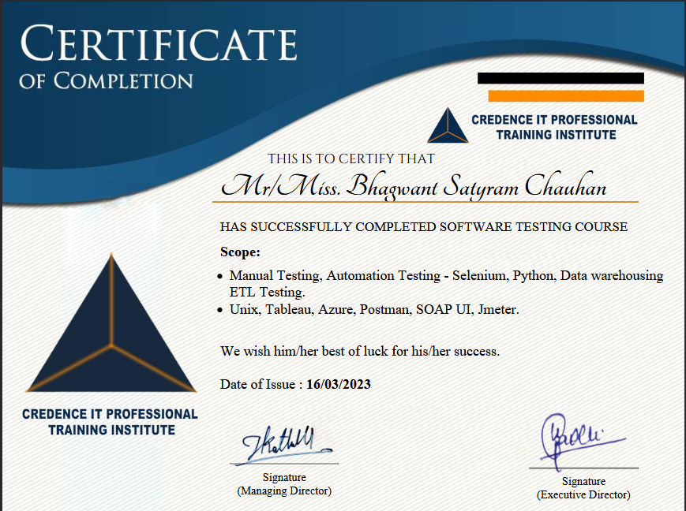
Course Certificate
After completing this course, you will get a Certificate of Completion. This certificate shows that you worked hard, learned new skills, and are ready to use them in your job. It is proof that you finished the training successfully and are prepared to do great work in software testing

Slide 27
11
Credence Own Application for Notes and Classes

Slide 28
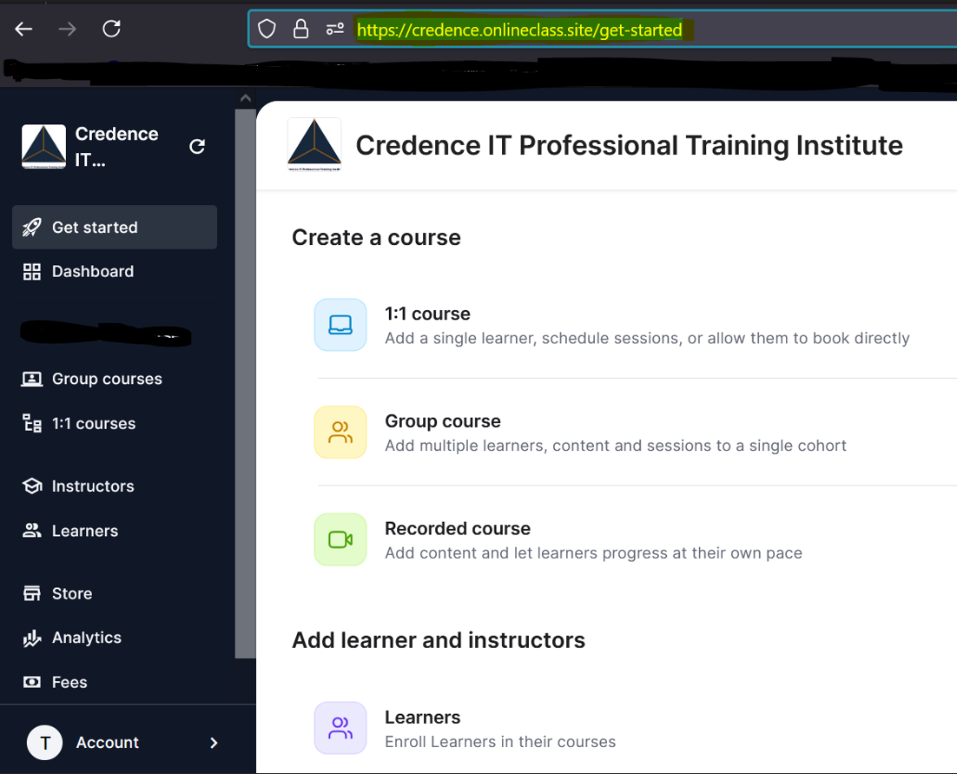
Credence Own Application for Notes and Classes
Our very own application, available for Android, iOS, and Windows/Mac devices. This application is designed to make learning simple and accessible from anywhere. With just a few taps, you can attend live classes, access course notes, view recorded sessions, and track your progress. The app ensures that all your learning materials are available in one convenient place, making your experience smooth and hassle-free, whether you're using a smartphone, tablet, or computer.

Slide 29
12
Laptop/System configuration

Slide 30
Laptop/System configuration
To specify the Laptop/System Configuration for a course, include the following details in simple English:
Operating System: Mention the required operating system –Windows.
Processor: Minimum required processor type and - Intel i3 or higher or similar AMD processor.
RAM: Minimum memory 4GB or higher.
Storage: Minimum required free space - 256GB or more, SSD is optional.
Graphics: No graphics card requirements.
Internet: Stable internet connection.
Summary :
OS: Windows
Processor: Minimum Intel i3 or similar AMD
RAM: 4GB+
Storage: 256GB+ (SSD optional)
Graphics: Not required
Note: This is the minimum configuration. You can choose a similar or higher configuration.

Slide 31
13
Tuition Fees Structures
For Fees structure and instalment details Kindly Connect with HR & Management Team : Contact No : 📞 +91 8237916162
📞 +91 7391053250
📞 +91 9579064658

Slide 32
Credence IT Professional
Training Institute
Thank you !
Contact No : 📞 +91 8237916162
📞 +91 7391053250
📞 +91 9579064658
📞 +91 9091929355
Email : 📧 info@credence.in
Web Site : 🌐 www.credence.in
Office Address : 14, Santosh Society, Talajai Pathar, Dhankawadi, Pune, Maharashtra 411043

